Slide 1
Visual Literacy
Professional Development Workshop for High School Teachers
Shoshana Gray & Staci Greenwald
Notes:
Shoshana
Start with
http://www.youtube.com/watch#playnext=1&playnext_from=TL&videos=-P8bD0yWNdI&v=XQNbAtK3c3g
Say a few words about the video and then transition to the objectives.

Slide 2
Objectives
Understand the concepts involved in visual literacy
Understand the importance of visual literacy
Become aware of your own visual literacy
Learn how to use visual tools in your classroom to increase your students’ visual literacy
Notes:
Shoshana

Slide 3
What is Visual Literacy?
“Visual literacy is the learned ability to interpret visual messages accurately and to create such messages (Heinich, et. al. as cited in Pettersson, 2009, p. 38).
  Xtranormal Video
  Images combine all media forms and are a synthesis of language, discourse, and viewing (2). ~Ron Burnett
Notes:
Staci
Here is a short video we created to give you a very brief overview of visual literacy, using a visual tool.
http://www.xtranormal.com/watch/6313487/

Slide 4
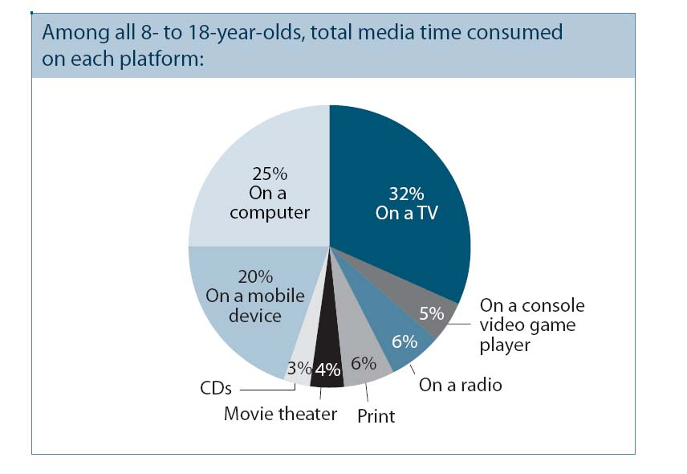
Why is it important?
[Data from 2009]
From the Kaiser Family Foundation Report:
Generation M2: Media in the Lives of 8-to-18-year-olds
Notes:
Staci
According to the study Generation M2: Media in the Lives of 8-18-year-olds, children spend only 15% of their media engagement with primarily non-visual media sources such as the radio, CDs, and print media.
Although print often includes some visual content as well. Visual media is what today’s children know and understand.
Flynt & Brozo point out in their article, Visual Literacy and the Content Classroom: A Question of Now, Now When, that students are going to use, explore and create visual content with or without our assistance.
If, however, we see this interest as an opportunity and integrate visual literacy into our classrooms, we can increase the interests of our students while, at the same time, ensuring that they receive the valuable skills to process this information.
Visual literacy skills are essential tools for guiding students to be active instead of passive receivers of visual messages, to separate the necessary from the unnecessary, to recognize the various functions of visual media (like information, persuasion, instruction, and entertainment), and to distinguish the superficial and glamorous from the truly meaningful messages.
Rideout, V. J., Foehr, U. G., & Roberts, D. F. (2010, January). Generation m2: Media in the lives of 8- to 18-year-olds. Retrieved from The Kaiser Family Foundation website: http://www.kff.org/‌entmedia/‌upload/‌8010.pdf
This report “is the third in a series of large-scale, nationally representative surveys by the Foundation about young people’s media use. It includes data from all three waves of the study (1999, 2004, and 2009), and is among the largest and most comprehensive publicly available sources of information about media use among American youth” ((Rideout, Foehr, & Roberts, 2010).

Slide 5


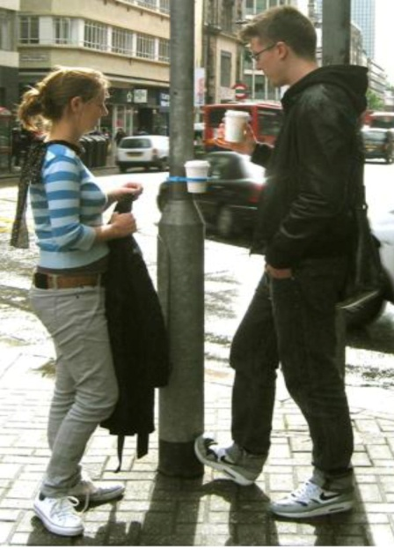
How do images communicate?
Design
Association
Context
Notes:
Staci
Images communicate messages in a multitude of ways including design, association and context.

Slide 6




Design
Shape
Angles/Direction
Color
Placement
The intersections of creativity, viewing, and critical reflection are fundamental to the very act of engaging with images in all of their forms (13). ~Ron Burnett
Images: Microsoft Office 2007 clipart
Notes:
Staci
I am going to begin with an overview of design.
For our purposes today we are going to concentrate on 4 basic elements of design: Shape, Angles or Direction, Color, and Placement.
Shape:
Pointed shapes are threatening
Rounded shapes and curves are comforting and evoke a sense of security
Larger shapes are stronger than smaller shapes
Angles/Direction:
horizontal shaped give a sense of stability and calm
Vertical shapes provide a sense of balance and energy
Diagonal shapes imply motion or tension
Color:
Lighter colors are safer than darker colors particularly in backgrounds. (Like day and night, night is more threatening because we can’t see as well)
Color provides a strong point of association, so when two object in an image are the same color, we usually associate them with one another.
Placement:
The upper half of the picture represents freedom, happiness, and triumph
The bottom half is heavier, sadder, constrained, and threatened. It can also feel more grounded depending on usage
The center of the page is the center of attention and attraction

Slide 7

Design
(Bang, M., 2000, p. 17)
Notes:
Staci
All of these design examples are from Molly Bang’s Picture This: How Pictures Work, which can be found in your handout.
This first image is just a basic representation of Little Red Riding Hood
Vertical trees are balanced and give off positive energy
Large, solid, red triangle stands out and is a figure of stability

Slide 8


Design
(Bang, M., 2000, p. 23)
Notes:
Staci
Red triangle is smaller and less powerful now.
Some trees are at an angle and even cause Red to appear trapped in their space.
These trees are unpredictable and unstable. They add tension to the image.

Slide 9

Design
(Bang, M., 2000, p. 40)
Notes:
Staci
In the final image we now have the wolf as well.
Wolf is much larger than the triangle, dominates the image.
The shapes of the wolf are pointed and threatening.
The tongue and eye are both red like the triangle, so we associate them with her…”the better to see/eat you with”
The red eye is looking at her, and the red tongue is drawing her into the wolf’s mouth.
The background is darker, implying night setting in, or at least a darkening of the woods…dark is scary
The contrasting white teeth pop, making them more noticeable…this wolf is ready to eat that triangle.

Slide 10
Associations with Images
What are your emotions as you view this image?
Does it remind you of something?
Does it have a connection with something else that is commonly understood?
shutterstock.com
Notes:
Shoshana
Last week, when we learned about reading strategies, we were informed that one strategy we learn to use when we read is association, or the connections we have with the things we read. This helps us to create meaning of the text. A similar process transpires when we view images and discern their meaning.
When we speak of textual literacy, we speak about denotation and connotation. Denotation, you will remember, is the dictionary definition of the word, while connotation relates to the personal and emotional connections one has with the word. Connections are what formulate one’s associations. The same is true for images.
When we look at images, our brains register what the image is—an apple, a tree, a car, etc. But something happens in our brains beyond that. As we travel through the experience of life, we begin to hook emotions and personal connections to certain images.
Most of us have had a personal experience of reading a book at a young age and rereading that same book when we are much older. We usually marvel at the fact that we feel so differently about it. Why is that. The reason is related to our personal experiences and how they have changed us.
For example, the image on the slide of two people holding hands will mean something different to you in puberty than it does in your older years. In puberty, you may view this connection with hopeful ideals; perhaps, in later years, after experiences of many relationships, you may have a different, more realistic view. These feelings and connections will arise simply by viewing the image that triggers them and it will impact the meaning that you create from the image.
I’m going to show you five slides of images and give you several seconds to experience them. Be aware of the process within yourself as you view the images. What is your initial interpretation the second you see the image, then, be aware of what happens to your emotions and why. What do you personally associate with these images. Jot down some notes if you need to, if you feel inclined to share at the end of the five slides.

Slide 11

http://preparednesspro.wordpress.com/2009/09/08/the-next-911/heart-of-a-soldier-james-b-stewart/
Notes:
Shoshana
Twin towers being bombed on 9/11.
For most Americans, this will be a tragic, emotional association, as it illustrates the first time we have been attacked in the continental United States.

Slide 12
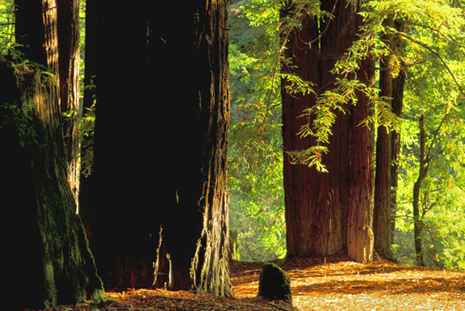
http://www.terragalleria.com/parks/np-image.redw20669.html via Google images
Notes:
Shoshana
California Redwoods
Typically, positive associations exist with nature. These are some of the oldest trees on the planet. Some might associate these trees with history and all that has transpired around them through the years.

Slide 13

Photograph by Simon Howden; accessed via freedigitalphotos.net.
Notes:
Shoshana
Butcher’s bloodied knife on cutting board with remnants of meat.
For some this might be simply what it is—the mess left after a butcher does his job. For others, the bloodied knife might connect up with violence. For vegetarians, this image might be quite disgusting.

Slide 14

Photograph by Suat Eman; accessed via freedigitalphotos.net.
Notes:
Shoshana
Construction crane
Some may connect a construction crane to progress, while others might connect it with feelings of devastation. What about the monochromatic tones and industrial setting?

Slide 15

http://www.geraldbrimacombe.com/west_coast_1.htm via Google Images.
Notes:
Shoshana
Oregon – Bandon by the Sea
Typically, positive associations of relaxation due to colors and nature. May have associations of fantasy, castles, etc. because of shapes of rocks. Mystery or excitement might be associated.

Slide 16

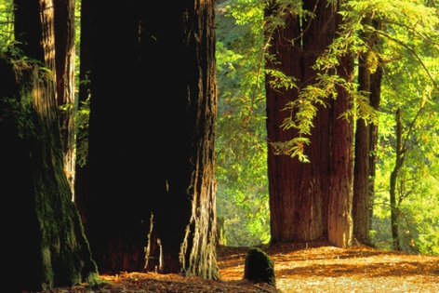

Image Association Discussion
What happened when you viewed these images?
Notes:
Shoshana
Spend a couple minutes discussing the associations of those in the group who care to share them.
Twin towers being bombed on 9/11.
For most Americans, this will be a tragic, emotional association, as it illustrates the first time we have been attacked in the continental United States.
California Redwoods
Typically, positive associations exist with nature. These are some of the oldest trees on the planet. Some might associate these trees with history and all that has transpired around them through the years.
Butcher’s bloodied knife on cutting board with remnants of meat.
For some this might be simply what it is—the mess left after a butcher does his job. For others, the bloodied knife might connect up with violence. For vegetarians, this image might be quite disgusting.
Construction crane
Some may connect a construction crane to progress, while others might connect it with feelings of devastation. What about the monochromatic tones and industrial setting?
Oregon
Typically, positive associations of relaxation due to colors and nature. May have associations of fantasy, castles, etc. because of shapes of rocks. Mystery or excitement might be associated.

Slide 17
Context of Images
What is the relative context of the image?
Is it placed together with other images?
Has it been manipulated?
Does it have a caption or text associated with it?
There is no such thing as an image divorced from a variety of media or social contexts of use and application (6).
~Ron Burnett
Notes:
Shoshana
Images in and of themselves are powerful because they instantly trigger emotion and meaning, as we have seen.
Add to this the manipulation of “relative context” and you have real power. Relative context refers to how the image is placed relative to its environment or other images, text, or media. The context in which an image is shown adds volumes to the meaning the viewer will interpret.
Advertisers understand these dynamics. Advertisements are some of the best illustrations of the power of images. Quick discussions of advertisements are excellent opportunities for you to engage in conversations about visual literacy with your students.
Today, most of us are aware of the fact that images of celebrities are air-brushed to remove any imperfections. Many young people have probably engaged in photo manipulation using Photo Shop or some other software. Awareness of the manipulation of images is a start, but increasing the understanding “relative context” is just as important to developing critical thinking skills.
We must become guardians of our own thinking as the power of manipulation increases with the ever-abounding use of images in relative context.

Slide 18

What is the Purpose?
Notes:
Shoshana
Seems to be a photo of two people talking on a city corner…(image altered for this purpose)

Slide 19
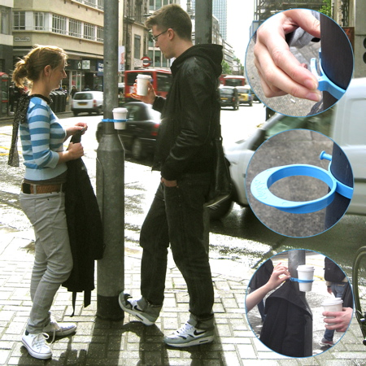
Purpose Now?
http://www.dezeen.com/category/events/new-designers-07/
Notes:
Shoshana
Clearly this image is illustrating the usefulness of an urban product which can hold your coffee cup and your jacket as you wait for the bus or what have you.

Slide 20
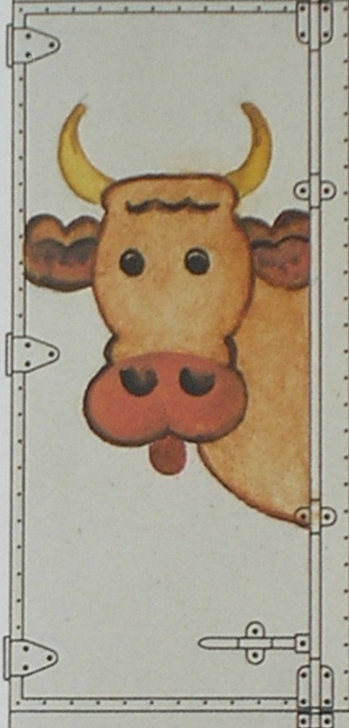
Image of a Cow…
(Wilde & Wilde, 1991, p. 119)
Notes:
Shoshana
An image of a cow…

Slide 21
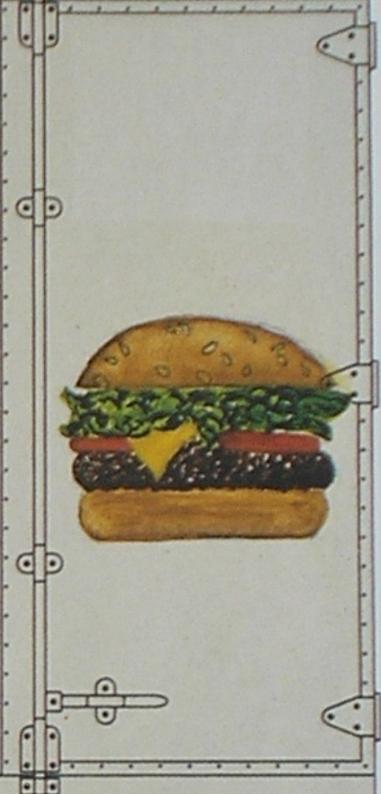
Before and After
(Wilde & Wilde, 1991, p. 119)
Notes:
Shoshana
Placed together with an image of a hamburger, the meaning changes. This could now be a “before and after” representation.

Slide 22
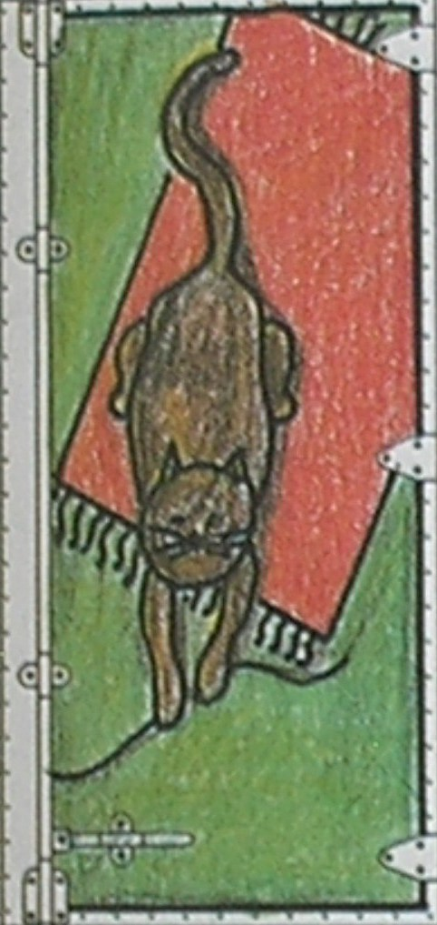
A cat playing with a string…
(Wilde & Wilde, 1991, p. 115)
Notes:
Shoshana

Slide 23
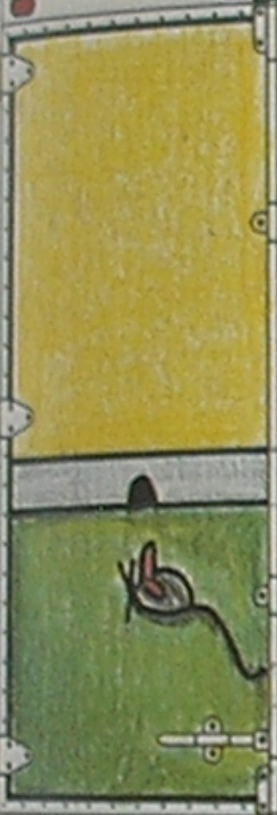
A cat playing with a mouse.
(Wilde & Wilde, 1991, p. 115)
Notes:
Shoshana
Same image but in relative context with another changes the meaning altogether.
While the image of the cat playing with a string might bring up warm associations, the image of the cat playing with a mouse might bring up a whole scenario of prey hunting predator, just by adding another piece to the puzzle.
Why is this important? Placing images in close proximity to other images can significantly alter meaning. Advertisers and politicians, and even newscasters use this technique as a subtext to the words they speak. We must be cognizant of the manipulation behind the images and the context in which they are shown in order to discern meaning and expose possible “hidden agendas.”
This is very much like a cat and mouse game: while the cat seems to be playing with a string, he is really chasing our tail with the intent to eat us! Awareness can prevent us from being victims to this manipulation.

Slide 24
Exercise
Net Neutrality
In groups of 3, take a few minutes to discuss the images you saw in the video.
  What message did you receive?
  Identify elements of design, association, and context that lead you to understanding the images the way you did.
  Use the handout to focus your discussion and take notes.
Notes:
Shoshana
Pass out exercise handout
Show video: http://www.youtube.com/watch?v=cWt0XUocViE

Slide 25
Net Neutrality Video Discussion
What did you determine about:
  The audience to whom this was directed?
  The purpose for this video?
  Any indirect communication?
What visual clues lead to your interpretation ?
  Design
  Association
  Relative context
Notes:
Shoshana
Each group shares their views
Ideas about Net Neutrality video:
Repeated use of green to represent big business concerned only with money/profits.
Big business represented by UFO’s associated with aliens equating to an US and THEM mentality.
Black boy signifies US, (possible victim of big business) represented as minority and child = underdog/innocence.
Steps at end are illustrated with visuals, making them easy to remember (i.e. call = telephone; share = computers linked).
Audience: the everyday, average Internet user
Purpose: to inspire the user to work to save Internet by signing petition
Indirect Communication: to set up an US and THEM adversarial mentality which will trigger a survival response generating action.

Slide 26
Part II - Application
Now that you have an increased awareness of the power of visual images, how can you apply this to your teaching?
Images are no longer just representations or interpreters of human actions. They have become central to every activity that connects humans to each other and to technology. ~Ron Burnett
Notes:
Shoshana
So far, we have been working to build your own awareness and metacognition of the internal processes that take place as you view images.
It is critical that you have this intense awareness so that you can teach visual literacy to your students.
We know that effective teaching involves lessons that engage students. Today’s students are very visual learners. They have grown up with visual learning more so than previous generations. Many of their pleasurable activities involve visual media. As we referenced early on in our presentation 85 percent of the time, this generation is dealing with visual media.
So, adding visual media to your lessons is one important way to engage your students AND provide them with embedded lessons on visual literacy.

Slide 27

Application
Find ways to incorporate visual tools into your lesson plans.
  Benefits:
  Targets visual learners
  Provides outlet for teaching visual literacy
  Engages students
Microsoft Office 2007 clipart
Notes:
Staci
Adding visuals to your lessons does not mean you need to totally rework your lessons, nor does it necessarily have to involve a great deal of technology. For example, using the National Geographic website that Mary Marks showed us can greatly enhance a Social Studies lesson and be easily incorporated into an existing lesson plan.
Sometimes, just showing images or photographs related to a topic can generate further brainstorming and discussion.
On your handout, we have referenced other visual tools like the one we demonstrated with our Xtranormal video.
Demonstrating how to utilize all these tools exceeds the purpose of this presentation; however, when you explore these tools, you want to keep in mind your own expertise with the tool, the time involved to teach the students how to use the tool, and whether the use of the tool actually adds what you hope it will add to the lesson.

Slide 28
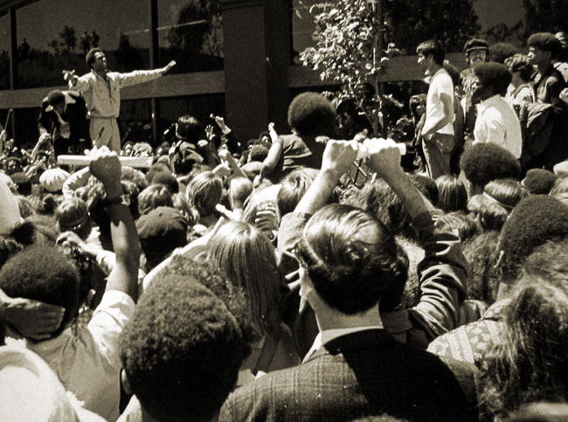
Caption Exercise
Oakland Museum of California. (2003)
Images can say a great deal, but they can speak differently to different people.
In this activity, you will pick the caption you feel best describes what is taking place in each photograph.
Notes:
Staci
This activity can be used with your students to illustrate that captions and viewer expectations can influence what we see or read into an image.

Slide 29
Application Exercise
Oakland Museum of California. (2003)
Notes:
Staci
Examine this picture.
What do you think is happening here?
Does any particular event or situation come to mind immediately?
Does it evoke any emotions or do you feel fairly neutral about it?

Slide 30
Application Exercise
Thousands attend “Welcome Home” rally for Arthur Ashe after his history-making win at Wimbledon.
Oakland Museum of California. (2003)
Notes:
Staci
What happens to your initial response when a caption is added?

Slide 31
Application Exercise
Huey P. Newton, co-founder of the Black Panther Party, addresses a crowd of supporters in front of the Alameda County Courthouse in Oakland.
Notes:
Staci
Or when the caption is changed?

Slide 32
Application Exercise
Singer Damon Harris motivates the crowd outside the Bateson Building in Sacramento during a peaceful protest against the ban on interracial marriages.
Oakland Museum of California. (2003)
Notes:
Staci
And changed again?

Slide 33
Caption Exercise
Which is the correct caption?
Thousands attend “Welcome Home” rally for Arthur Ashe after his history-making win at Wimbledon.
Huey P. Newton, co-founder of the Black Panther Party, addresses a crowd of supporters in front of the Alameda County Courthouse in Oakland.
Temptations singer, Damon Harris, serenades a crowd of peaceful protesters outside the Bateson Building in Sacramento.
Oakland Museum of California. (2003)
Notes:
Staci
So, which is the correct caption?
Thousands attend “Welcome Home” rally for Arthur Ashe after his history-making win at Wimbledon.
Huey P. Newton, co-founder of the Black Panther Party, addresses a crowd of supporters in front of the Alameda County Courthouse in Oakland.
Temptations singer, Damon Harris, serenades a crowd of peaceful protesters outside the Bateson Building in Sacramento.
Correct answer: #2 Huey P. Newton, co-founder of the Black Panther Party, addresses a crowd of supporters in front of the Alameda County Courthouse in Oakland.

Slide 34
Caption Exercise
Which is the correct caption?
Thousands attend “Welcome Home” rally for Arthur Ashe after his history-making win at Wimbledon.
Huey P. Newton, co-founder of the Black Panther Party, addresses a crowd of supporters in front of the Alameda County Courthouse in Oakland.
Temptations singer, Damon Harris, serenades a crowd of peaceful protesters outside the Bateson Building in Sacramento.
Huey P. Newton, co-founder of the Black Panther Party, addresses a crowd of supporters in front of the Alameda County Courthouse in Oakland.
Oakland Museum of California. (2003)
Notes:
Staci
So, which is the correct caption?
Thousands attend “Welcome Home” rally for Arthur Ashe after his history-making win at Wimbledon.
Huey P. Newton, co-founder of the Black Panther Party, addresses a crowd of supporters in front of the Alameda County Courthouse in Oakland.
Temptations singer, Damon Harris, serenades a crowd of peaceful protesters outside the Bateson Building in Sacramento.
Correct answer: #2 Huey P. Newton, co-founder of the Black Panther Party, addresses a crowd of supporters in front of the Alameda County Courthouse in Oakland.

Slide 35
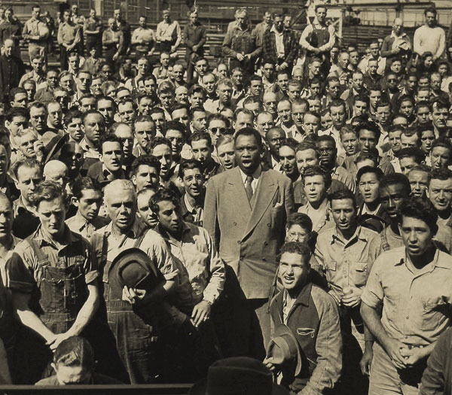
Application Exercise
Correct answer:
#2 Entertainer Paul Robeson sings to laborers working at the racially integrated Moore Shipyards in Oakland, California, on September 21, 1942.
Oakland Museum of California. (2003)
Notes:
Staci
Ok, now take a moment to look at the exercises we’ve handed out. Take a few moments to read each image and determine which is the correct caption.
Image 1
Onlookers pay their respects during a memorial procession honoring their fallen neighbors following the bombing of Pearl Harbor.
Entertainer Paul Robeson sings to laborers working at the racially integrated Moore Shipyards in Oakland, California, on September 21, 1942.
A mournful crowd gathers to watch the funeral procession of Dr. Martin Luther King, Jr. drive past.
Answer will appear upon click
Correct answer: #2 Entertainer Paul Robeson sings to laborers working at the racially integrated Moore Shipyards in Oakland, California, on September 21, 1942.

Slide 36
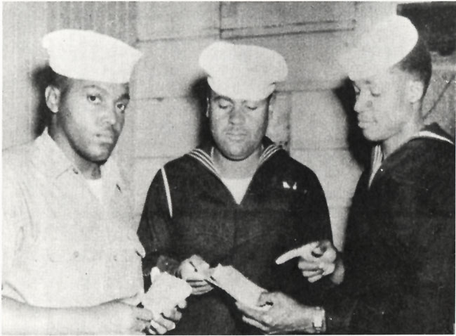
Application Exercise
Correct answer:
#3 Three First Class seamen stationed at Port Chicago examine the shrapnel remaining from the infamous 1944 explosion that killed 320 sailors.
Oakland Museum of California. (2003)
Notes:
Staci
Image 2
American First Class seamen review the details of their next assignment following their victory in the Battle of the Coral Sea.
World War II sailors look in disgust at food rations, which have hardened into rock-like structures.
Three First Class seamen stationed at Port Chicago examine the shrapnel remaining from the infamous 1944 explosion that killed 320 sailors.
Answer will appear upon click
Correct answer: #3 Three First Class seamen stationed at Port Chicago examine the shrapnel remaining from the infamous 1944 explosion that killed 320 sailors.

Slide 37
Application
Capitalize on teachable moments that come up spontaneously in classroom discussions.
  Advertisements
  Elections
  Movies
  Crucially, it is the many ways in which images “materialize” metaphors that gives them such transformative power (42). ~Ron Burnett
Notes:
Staci
It is also important to capitalize on teachable moments and students’ interests.
When discussions arise in the classroom regarding popular culture (videogames, movies, etc.) and current events (newscasts, elections, etc.), use the opportunity to question students on how they drew the conclusions they did.
Students are inundated with visual media. Help them to develop critical thinking skills in analyzing visual media. Verbalize the three criteria: design, associations, and context in order to model how to approach analyzing visual media. Discuss audience, purpose, and hidden agendas.

Slide 38

Application
Seglem, R., & Witte, S. (2009, November). You gotta see it to believe it: Teaching visual literacy in the English classroom. Journal of Adolescent & Adult Literacy, 53(3), 216-226. doi:10.1598/‌JAAL.53.3.3
  By teaching students how to read and view all texts critically, not just the traditional print texts, teachers can build upon the skills students need to read and write, increasing their literacy levels in all areas (224). ~Seglem & Witte
Microsoft Office 2007 clipart
Notes:
You can even capitalize on the connection between students’ everyday lives and culture and their education. Bring what they already know into the classroom and use it to teach them what they need to know. Visual messages are a great way to do this.
In our handout you will find numerous resources for visual literacy lesson plans and activities on the Internet as well as some of the articles we have included. One such article is You gotta see it to believe it: Teaching visual literacy in the English classroom, by Robyn Seglem and Shelbia Witte. (Perhaps you are familiar with their writings already?) This article provides several examples of lessons that the authors have actually used in their high school English classes with great success.
(It’s a great jumping off point for designing your own lessons and those they present are certainly good enough to borrow yourself.)

Slide 39

Conclusion
Microsoft Office 2007 clipart
Notes:
Staci
Hopefully we have provided you with a basic understanding of
What visual literacy is
Why it is important
And how to incorporate it into your classroom
We have included various visual literacy resources in your handout that can help you build your own visual literacy skills and use images more effectively.

Slide 40
Sources
Bang, M. (2000). Picture this: How pictures work. San Francisco: SeaStar Books.
Burnett, R. (2004). How images think. Massachusetts Institute of Technology.
Flynt, E. S., & Brozo, W. (2010, March). Visual literacy and the content classroom: A question of now, not when. The Reading Teacher, 63(6), 526-528. doi:10.1598/‌RT.63.6.11
Oakland Museum of California. (2003). Visual literacy activities. In Picture
this. Retrieved from http://museumca.org/picturethis/visual.html
Rideout, V. J., Foehr, U. G., & Roberts, D. F. (2010, January). Generation m2: Media in the lives of 8- to 18-year-olds. Retrieved from The Kaiser Family Foundation website: http://www.kff.org/‌entmedia/‌upload/‌8010.pdf
Seglem, R., & Witte, S. (2009, November). You gotta see it to believe it: Teaching visual literacy in the English classroom. Journal of Adolescent & Adult Literacy, 53(3), 216-226. doi:10.1598/‌JAAL.53.3.3
Wilde, J., & Wilde, R. (1991). Visual literacy: A conceptual approach to graphic problem solving. New York: Watson-Guptil Publications.
  Image Sources cited on each slide

